Slide 1
Lecture -11
Application of Fourier Transform

Slide 2
Objective
To apply Fourier transform to solve partial differential equation

Slide 3
Application of Fourier Transform
Solutions of partial differential equations (Boundary Value Problem) by Fourier transform:
Finite Fourier transforms of partial derivatives
(1) sine transformation
(2) cosine transformation

Slide 4
Application of Fourier Transform
Selection of finite sine and cosine transform
We shall decide the choice of finite sine or cosine transform by the form of boundary conditions, such that
The conditions and , that is finite sine transformation.
The conditions and or , that is finite cosine transformation.

Slide 5
Application of Fourier Transform
Example:
Use the Fourier transformation to solve the following boundary value problem
Solution: Given that,
Step 1: Taking both sides finite sine transformation

Slide 6
Application of Fourier Transform
Step 2: Let,

Slide 7
Application of Fourier Transform
Step 3:

Slide 8
Application of Fourier Transform
Step 4: Now, from equation (iii), we get
So, sine transformation is

Slide 9
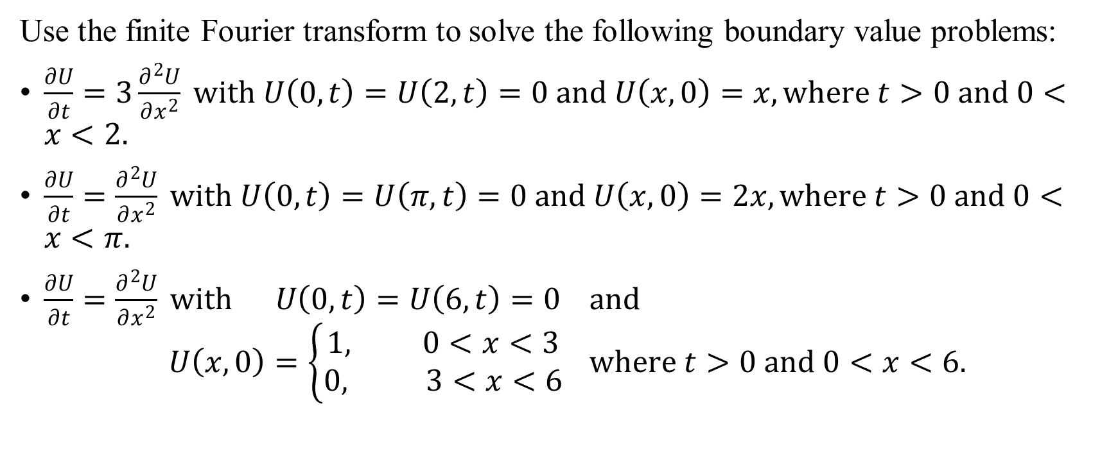
Sample Exercise
Use the finite Fourier transform to solve the following boundary value problems:
$\frac{∂U}{∂t}=3\frac{∂^{2}U}{∂x^{2}} with U\left(0,t\right)=U\left(2,t\right)=0 and U\left(x,0\right)=x, where t>0 and 0<x<2.$
$\frac{∂U}{∂t}=\frac{∂^{2}U}{∂x^{2}} with U\left(0,t\right)=U\left(π,t\right)=0 and U\left(x,0\right)=2x, where t>0 and 0<x<π.$
$\frac{∂U}{∂t}=\frac{∂^{2}U}{∂x^{2}} with U\left(0,t\right)=U\left(6,t\right)=0 and$
$$U\left(x,0\right)=\left\{\begin{aligned}1, 0<x<3 \\ 0, 3<x<6\end{aligned}\right. where t>0 and 0<x<6.$$

Slide 10
Outcome
After this lecture student will be able to
Apply Fourier transform to solve partial differential equation

Slide 11
Next class
Discrete Fourier transform

